Slide 1
JUnit 4 For Unit Testing

Slide 2


Unit Testing Introduction
- What is unit testing? - Test coverage
- Unit testing in Java
JUnit4 introduction
- Demo : JUnit4 Simple Example using Eclipse
- JUnit4 annotations
- Demo : JUnit4 annotations
- JUnit4 assertions

Slide 3
Demo : JUnit4 complete example using Eclipse
- Initial Steps
- Create the java class to be tested - Create and run a JUnit test case
- Using @Ignore annotation
- Creating Test Suites
- Creating parameterized tests
- Rules
- Collections and Arrays in JUnit Tests
- Run JUnit tests from command line

Slide 4
Benchmark Java Code Using JUnit and JMH - What is JMH?
- Maven dependency
- Writing your first JMH benchmark
- Blackhole - benchmark without JVM interference
- Scopes in @State annotation
- Analyzing results
- Summary

Slide 5
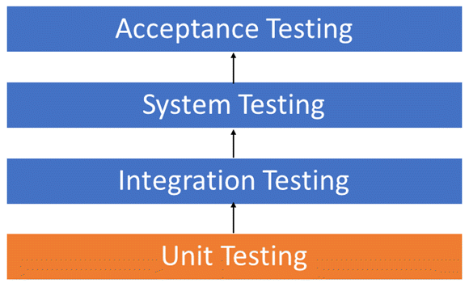
What is unit testing?

Slide 6

Test coverage
Test coverage is an important indicator in software testing in terms of quality and effectiveness.

Slide 7
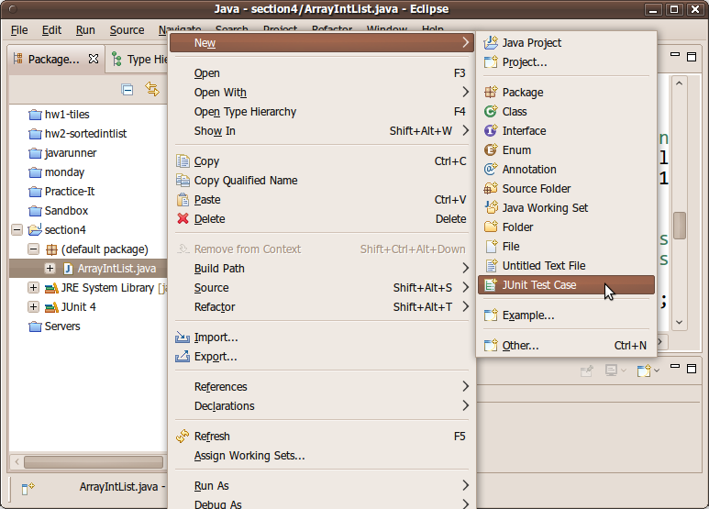
Unit testing in Java

Slide 8
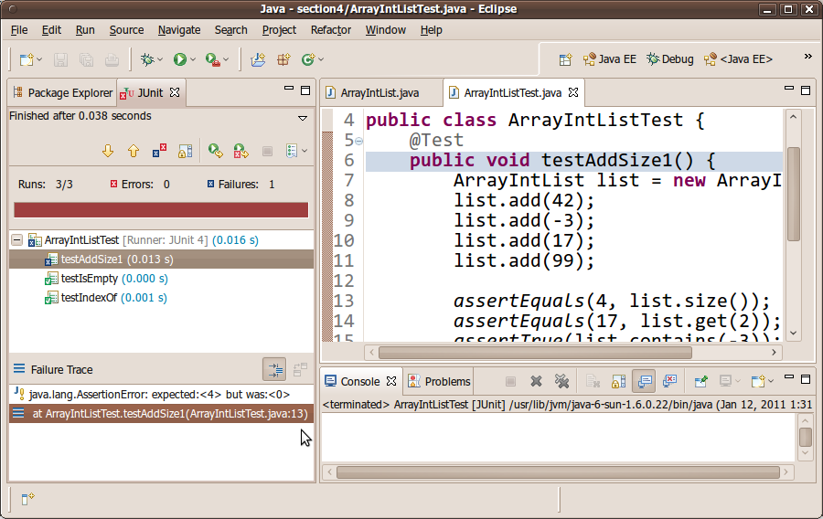
Unit testing in Java

Slide 9
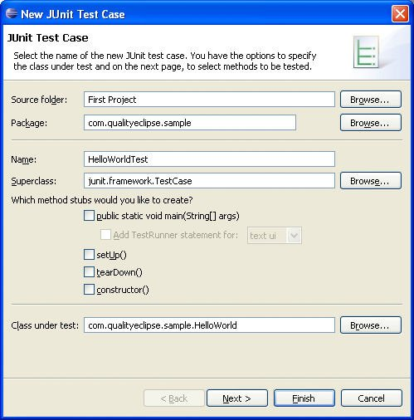
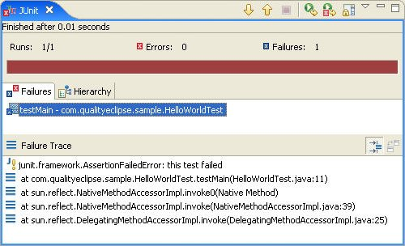
JUnit introduction

Slide 10


JUnit4 Simple Example using Eclipse

Slide 11
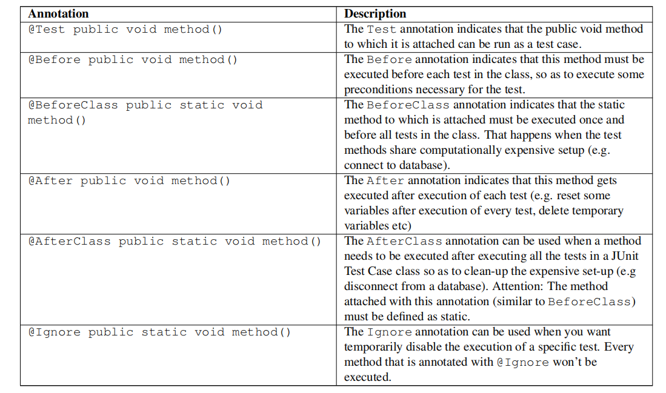
JUnit annotations

Slide 12
JUnit4 Annotations Example using Eclipse

Slide 13
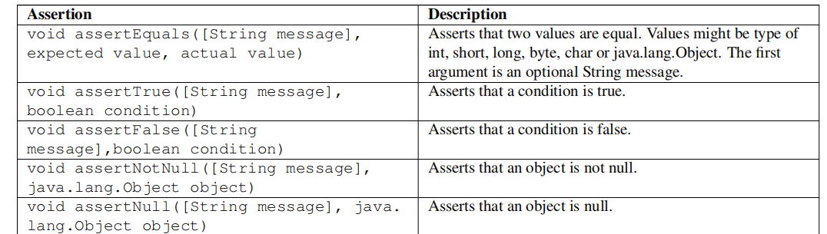
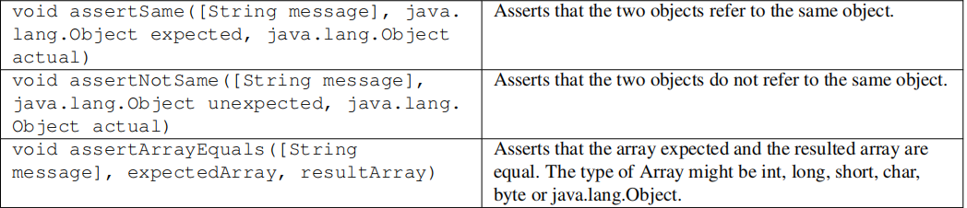
JUnit assertions

Slide 14
JUnit4 complete example using Eclipse

Slide 15
Using @Ignore annotation

Slide 16
Using @Ignore annotation

Slide 17
Using @Ignore annotation

Slide 18
Test Suites

Slide 19
What Is a Parameterized Test?
When it fullfills all the following requirements:
- The class is annotated with @RunWith(Parameterized.class).
- The class has a single constructor that stores the test data
- The class has a static method that generates and returns test data and is annotated with the @Parameters annotation.
- The class has a test, which obviously means that it needs a method annotated with the @Test annotation.

Slide 20
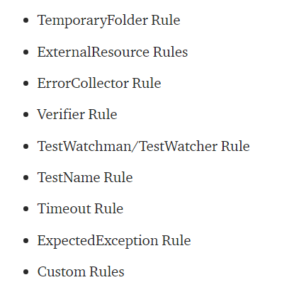
Rules

Slide 21
TestName Rule
TemporaryFolder Rule - How a JUnit Rule Works
ExpectedException Rule
Timeout Rule
Error Collector Rule
Creating a Custom JUnit Rule

Slide 22
What is JMH?
- JMH is an Open JDK tool that helps to implement benchmarks correctly.
- JMH specializes in micro-benchmarks where low-level performance metrics are measured.
- Micro-benchmarks are useful for in-depth analysis of performance issues.
- Writing JMH benchmarks are similar to writing JUnit test cases.
- The only difference is with the annotations used in JMH.

Slide 23

Maven dependency

Slide 24

Writing your first JMH benchmark

Slide 25
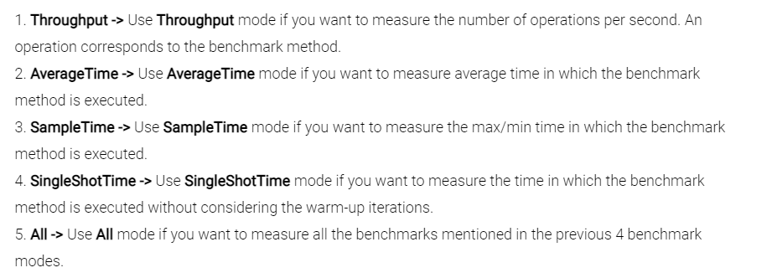
Benchmark Modes

Slide 26

Blackhole - benchmark without JVM interference

Slide 27

Blackhole to the Rescue

Slide 28

@State annotation

Slide 29
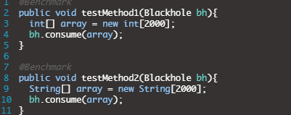
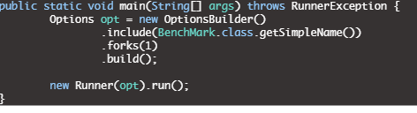
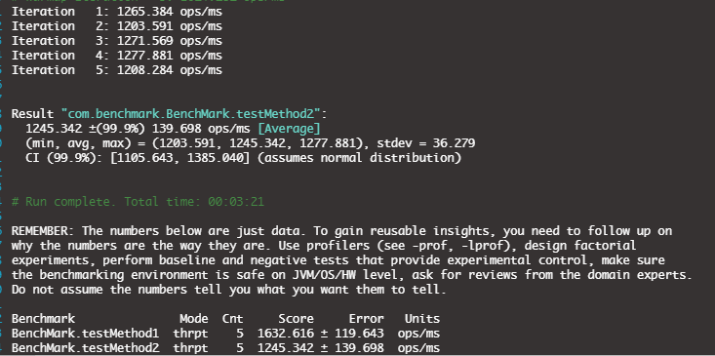
Comparing two benchmark methods

Slide 30
JMH is a Java harness for building, running, and analysing nano/micro/milli/macro benchmarks written in Java and other languages targeting the JVM.
Summary

